Slide 1
Hot Topics In Pharmaceutical Brands: Rx Brand (Restrictions) and Patient Safety
ASIPI Conference
Bogotá, Columbia
Tuesday, April 10, 2018
John R. Rudolph, LL.B., Ph.D.
Assistant General Counsel
Trademark Attorney
© 2018 Eli Lilly and Company

Slide 2
Agenda
1. Patients are at Risk
  Medical Errors can result in death
  Medical Errors Defined
  Trademarks are just one element
2. Trademarks Regulatory Oversight – Different Countries have Different approaches:
  Mexico
  Brazil
  Argentina
  Chile
  US
  EU
  Canada
3. Approaches to Naming Medicines
4. ISMP view of Medication Error – Brand Names & Generic Names
5. Generic Naming alone – potentially harmful to patients
6. Trademarks/Patient Safety and POCA
POCA approach and avoiding elements of generic names - Examples

Slide 3
Medical errors can result in death
Health care in the United States is not as safe as it should be--and can be:
“At least 44,000 people, and perhaps as many as 98,000 people, die in hospitals each year * as a result of medical errors that could have been prevented, according to estimates from two major studies.”
  *Nov. 29, 1999 Institute of Medicine (IOM)
  To Err is Human: Building a Safer Health System:
Notes:
While this slide speaks yto the situation in the United States, the comment applies equally to any country around the world where humans are invloved in delivering health care..

Slide 4
  Nov. 29, 1999 Institute of Medicine (IOM)
  To Err is Human: Building a Safer Health System:
Medical Errors Defined
“[P]reventable medical errors in hospitals exceed attributable deaths to such feared threats as motor-vehicle wrecks, breast cancer, and AIDS.”
Medical errors can be defined as the failure of a planned action to be completed as intended or the use of a wrong plan to achieve an aim.
Medical errors include adverse drug events, improper transfusions, surgical injuries, wrong-site surgery, suicides, restraint-related injuries or death, falls, burns, pressure ulcers, and mistaken patient identities. High error rates with serious consequences are most likely to occur in intensive care units, operating rooms, and emergency departments.
The Institute of Medicine (IOM) is a private, nonprofit organization that provides health policy advice under a congressional charter granted to the National Academy of Sciences. For more information about the Institute of Medicine, visit the IOM home page at www.iom.edu.
Notes:
Note, that in this landmark report, trademarks, or :”drug names” is not defined as contributing to medical errors.

Slide 5
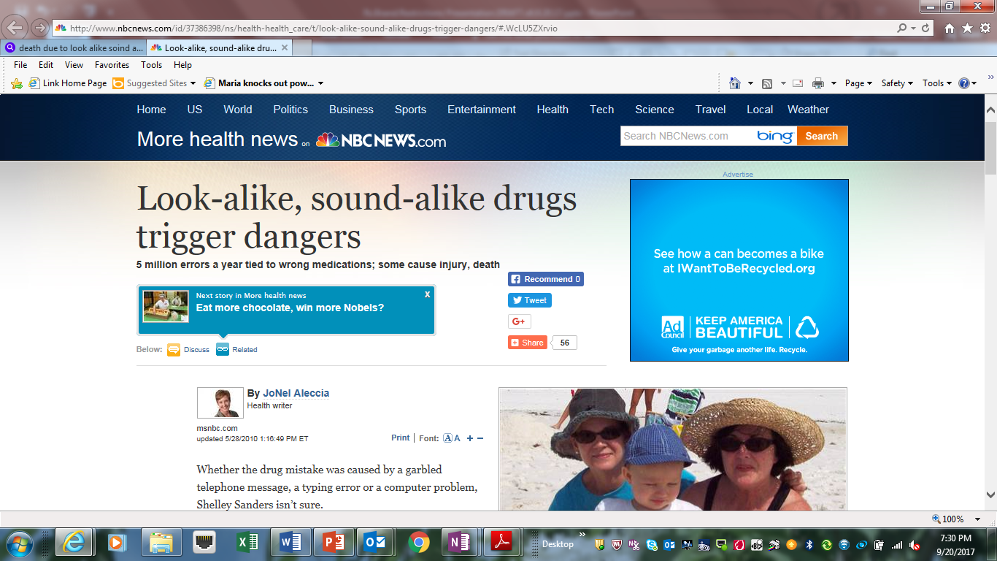
Drug Names get blamed for Medical Errors
“…62-year-old mother was supposed to get one kind of medication, a pain drug called Lyrica, but instead received another, an anti-epilepsy drug called Lamictal, and in an initial dose far higher than any doctor would recommend. “
Look Alike-Sound-Alike Drugs –
Trigger Danger
“Only afterward did [the family] learn that suicidal actions are a known risk of Lamictal and that [their] mother’s death closely followed one of the more than 5 million wrong-drug errors that occur each year, including many caused by similar-sounding mixed-up names.”
Notes:
“INCLUDING MANY CAUSED BY SIMILAR-SOUNDING MIXED-UP NAMES” BUT, would Lyrica and Lamictal have been expected to be confused on the basis of look-alike and sound alike?

Slide 6


Contributing Factors to
Medication Error
To Err is Human:
…a four-part plan that applies to all who are, or will be, at the front lines of patient care; clinical administrators; regulating, accrediting, and licensing groups; boards of directors; industry; and government agencies. It also suggested actions that patients and their families could take to improve safety.”
  Medication Errors:
  “Numerous factors in the health care system contribute to medication safety and errors. Some of these factors can be attributed directly to provider organizations, while others can be attributed to the medication-use system itself.”
Notes:
The point is eliminating, or dramatically reducing the potential for medical error due to trademark alone will not move the bar much on medication error. As the Institute of Medicine states “Numerous factors…”
So what have countries done to restrict trademarks in their countries

Slide 7

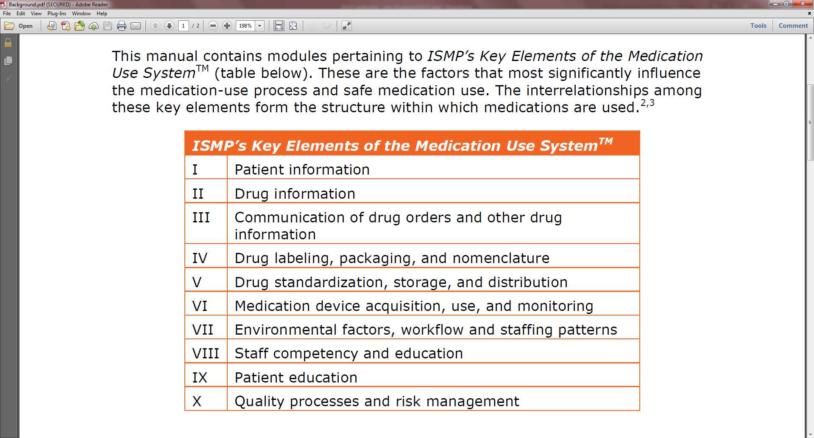
Factors contributing to Medication Error
  Trademarks - One element of a Complex Multifactoral Problem
Notes:
Look alike, Sound alike errors are but one element in a large number of factors which lead to medication error.

Slide 8
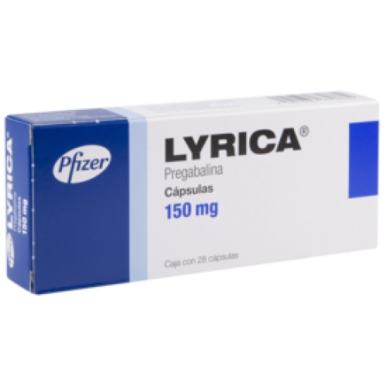
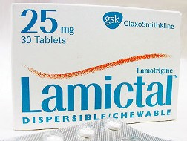
The Brands
Would Lyrica and Lamictal have been expected to be confused
on the basis of look-alike and sound alike names?
Likely Not: POCA is 49
It would be below the radar of US, Brazil, Mexico Canada and the EU.
To date there is no definitive evidence that the current regulatory oversight of trademarks is actually working to reduce medication errors
Regardless – In the case highlighted, a tragic outcome.
Notes:
The medication error was likely due to other error in the system of delivery of medicine to the patient, perhaps at the pharmacy level. Regardless, the outcome was tragic.

Slide 9
REGULATORY OVERSIGHT – Approaches to Trademarks
Regulatory Oversight – Different Countries have Different approaches:
  Mexico
  Brazil
  Argentina
  Chile
  US
  EU
  Canada

Slide 10

Mexico - COFEPRIS
DENOMINACIONES
DISTINTIVAS
Notes:
In Mexico, pursuant to the Health Law, according to articles 24, 91, 167, 169, 171, 172, 173, 174 and 177 of the Regulation for Health Products Consumption in order to obtain a “sanitary registration” for a Health Product, i.e., approval to market, a label proposal must be submitted, which must contain the distinctive denomination (Commercial trademark) of the product;
Like most other regulators, the General Health Law Regulation in regards to Advertising, does not authorize the advertising of medications that make statements or testimonies that may cause confusion to the public and that lack support – the classic “Misrepresentation” No statements or trademarks denoting superiority or efficacy

Slide 11
Mexico - COFEPRIS
Evaluación de las denominaciones distintivas
Notes:
GUIDELINES FOR THE USE OF DISTINCTIVE DENOMINATIONS OF MEDICATIONS - Current
The distinctive denominations of medications must be differentiated by at least three letters in each word;
Here is the challenge: that the distinctive denomination of two or more products, when spelled or are phonetically similar must be differentiated at least by three letters in each word; This is the General Health Law so-called ‘three-letter rule’, which requires a minimum difference of three letters between commercial names of pharmaceutical preparations in order for them to qualify for a health registration
Two words will be considered when there is a separations between both;
in distinctive denominations, punctuation signs and mathematical symbols may be used.
It is considered one word when there is a sign or unifying digit linking them.
The distinctive denomination as a whole must be in the same letter size.
The letter style, color and level in which is presented such denomination in packages and advertising, must allow, in such a case, a clear identification and identification between medications that are different.
The company interested in using such distinctive denominations which are similar between them, may do so as long as the medications belongs to the same company, of the same nature and corresponds to the same therapeutic group, according to article 224 section B of the General Health Law;
Revoked or pending registration must not be used; and the same distinctive denomination may only be used when dealing with different pharmaceutical forms or different dosages with the same active ingredient of the same laboratory.

Slide 12
Ventajas denominaciones
distintivas
La evaluacion de las denominaciones estará ligada a la
Dictaminacion del tramite
√
La gramática y fonética se evaluarán en el momento de ingresar los nombres en el sistema
√
Una vez que un nombre sea aprobado, el trámite pasará directamente al dictaminador asignado
√
Las empresas tendrán constancia de los motivos por los que la denominación fue rechazada
√
Las denominaciones serán evaluadas cada vez que se sometan a trámite
√
La implementación finalizará en junio de 2018
Notes:
COPEFRIS is evolving its approach and will be instituting a grammar and phonetics evaluation at the moment of entering the names in the system. Our hope is that it is based on a system similar to POCA which is used by Brazil – discussed shortly
The approach to be taken by COPEFRIS should be an improvement moving beyond the current seemingly arbitrary 3 letter rule taken with software which rejected proposed trademarks if there were more than 3 letters of similarity with existing marketed products.

Slide 13

Brazil -
Brazil’s name selection is regulated under RDC No. 59 of October 10, 2014
The following attributes of similarities and differences between the drugs are considered:
I. name of the medicinal product; II. active principle (s) of the medicinal product; III. therapeutic class; IV. proposed indication; V. pharmaceutical form; VI. route of administration VII. concentration; VIII. units of measure; IX. dosage units; X. recommended dosage; XI. typical quantity or volume; XII. frequency of administration; XIII. storage conditions; XIV. target population of patients; XV. population of health professionals; XVI. restriction of use; XVII. restriction of sale; XVIII. hospital use or not; XIX. reports of pharmacovigilance; XX. history of similar cases;

Slide 14
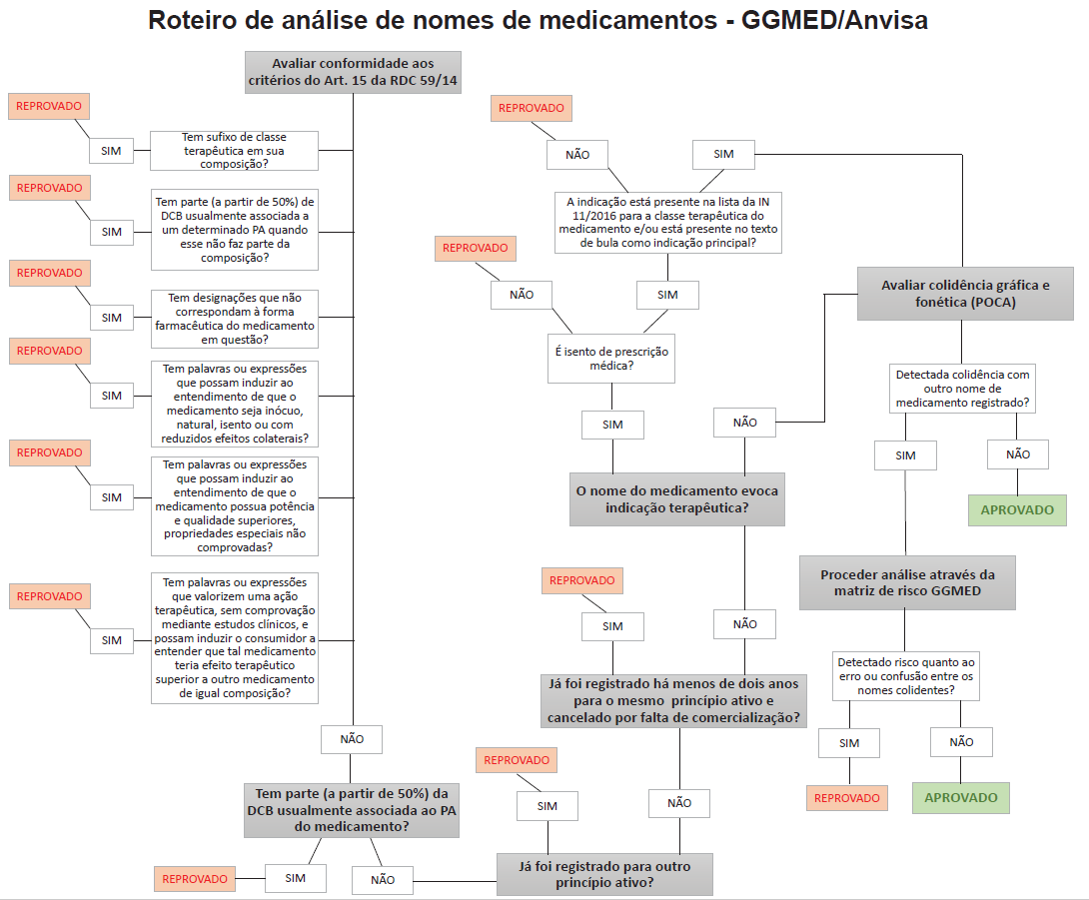

Slide 15
Brazil -
ANVISA encourages the use of POCA and has made it available on their ANVISA website
It advises that companies can perform spelling and phonetic analysis for the proposed drug names
Their POCA database is constantly updated according to the database of medicines registered in ANVISA's system.
ANVISA’s evaluation reflect the existing names at the time of application

Slide 16
Brazil -
Exemplos:
ATORVASTATINA cálcica
Nomes reprovados:
- ATORVAS (3 sílabas/7 letras)
- TORVASTA (3 sílabas/8 letras)
- ciTORVASTAlo (3 sílabas/8 letras)
- ATORciVASTA (4 sílabas/9 letras)
- ATORTINA (4 sílabas/8 letras)
- ATORTYNA (4 sílabas/8 letras)
- ORVASTA (2 sílabas/7 letras)
Nomes aprovados, neste critério:
- VASTA (2 sílabas/5 letras)
- ciVASTA (2 sílabas/5 letras)
- TORVAS (2 sílabas/6 letras)
- TORVASloca (2 sílabas/6 letras)

Slide 17

Chile – Instituto de Salud Pública
Chile’s oversight of the names of medicines comes from Sanitary Code, Decree N°725/1967
© 2018 Eli Lilly and Company

Slide 18
Chile – Instituto de Salud Pública
Bill to modify the Sanitary Code to regulate generic bio-equivalent drugs
and avoid vertical integration between laboratories and pharmacies has
two troublesome provisions:
1. Proposed Art. 1 No. 6 modifies Article 101 of the Sanitary Code in relation to the doctor’s prescription, eliminates the use of the "fanciful name" (or trademark) as an option for the doctor when prescribing a medication in the prescription, and requiring the doctor to do so, under any event, by its International Nonproprietary Name (INN).
2. Proposed Art. 128 bis contemplated in the Bill, referring to the labeling of the pharmaceutical product, imposes a strong limitation on the use of the trademark or fanciful name of the medicine, by requiring the INN to occupy at least one third of the space of one of the main faces of the package, while the fanciful name, if any, may not exceed one fifth of that used by the INN (ie, less than 6.7% of the main face of the package).

Slide 19
Chile – Instituto de Salud Pública
Chile – Visual implication
25 point font
ACETAMINOPHEN
5 point font
TYLENOL
Approximately 6.7% of label
Notes:
With measures like this, the trademark, may just “disappear.”
In Ecuador, with Presidential Decree 522, in January of 2015, an arguably even more restrictive approach is taken by the health regulator. There, once a medicine goes off patent, the manufacturer is required to remove its trademarks and move to a generic naming approach. Monica will discuss this in greater detail.

Slide 20

United States - FDA
DENOMINACIONES
DISTINTIVAS

Slide 21
FDA Oversight
  SCOPE:
  Human Prescription
  Human Non-prescription
  (Includes biologics)
  Three Areas of Focus:
  1. Design of the Product and its container closure system
  2. Container label and carton labeling design; and
  3. Developing and Selecting Proposed Proprietary Names
  GOAL:
  Practices to help “…not cause or contribute to medication errors, or otherwise contribute to the misbranding of the drug.”

Slide 22
The Guidances for
Proprietary Names
Guidance for Industry “Best Practices in Developing Proprietary Names for Drugs” U.S. Department of Health and Human Services Food and Drug Administration Center for Drug Evaluation and Research Center for Biologics Evaluation and Research May 2014 Drug Safety. https://www.fda.gov/ucm/groups/fdagov-public/@fdagov-drugs-gen/documents/document/ucm398997.pdf
“Contents of a Complete Submission for the Evaluation of Proprietary Names” Guidance for Industry U.S. Department of Health and Human Services Food and Drug Administration Center for Drug Evaluation and Research (CDER) Center for Biologics Evaluation and Research (CBER) - April 2016 - Labeling Revision 1.
https://www.fda.gov/ucm/groups/fdagov-public/@fdagov-drugs-gen/documents/document/ucm075068.pdf

Slide 23
The Guidances – Proprietary Names
“Best Practices in Developing Proprietary Names for Drugs”
FDA’s objections to proposed proprietary names are often for readily-identifiable reasons.
Practices outlined have led to names that FDA found objectionable and should be avoided
Proposed proprietary names that fail preliminary screening are unlikely to be viable candidates for FDA acceptance
A full assessment of safety and misbranding concerns is required for submission for FDA review.

Slide 24
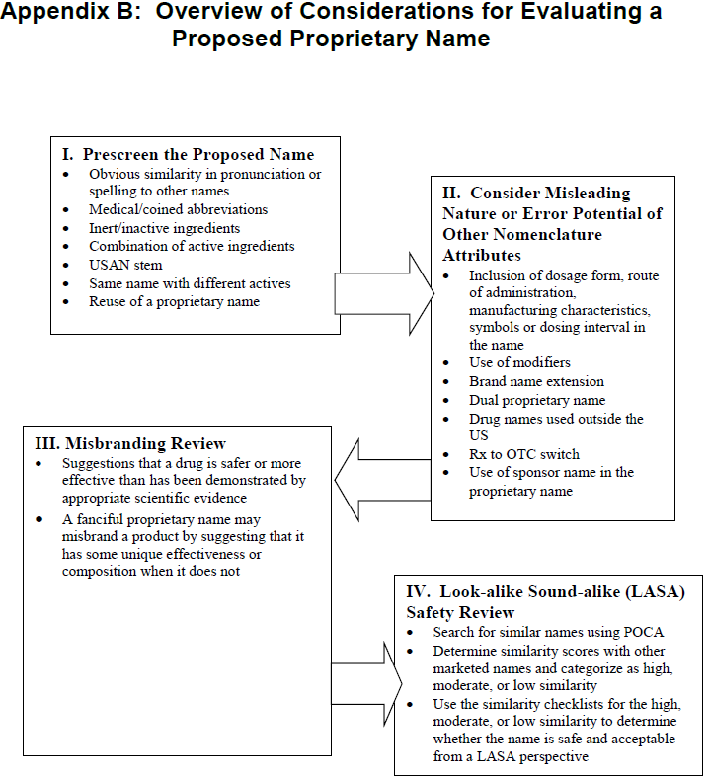
LASA Analysis and POCA <54% (LOW); >55 but <69% (MODERATE); >70% but <100% (HIGH)
© 2018 Eli Lilly and Company

Slide 25
CDER: FY10-FY17** Name Denial Reasons
CDER Denials by Fiscal Year (NDA/BLA and IND)
Reasons Identified for Rejection (Misbranding or Safety)* | 2010 # Reasons | 2011 # Reasons | 2012 # Reasons | 2013 # Reasons | 2014 # Reasons | 2015 # Reasons | 2016 # Reasons | 2017** # Reasons
Misbranding | 19 | 21 | 28 | 31 | 29 | 12 | 12 | 11
Safety (similar in spelling, writing, or pronunciation) | 177 | 170 | 199 | 120 | 72 | 81 | 108 | 51
Other Attributes Within the Name That Posed Risk for Error or Found to be Misleading | 35 | 27 | 41 | 40 | 14 | 22 | 19 | 10
* Some of the proposed proprietary name denials may include n multiple reasons serving as the basis for denial. Thus, the total # of reasons cited in any given year will exceed the total number # of denial decisions issued. **FY 2017 CDER data from 01- Oct- 2016 through 14-Jun- 2017

Slide 26
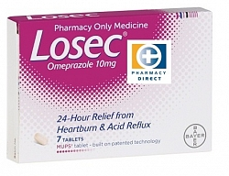
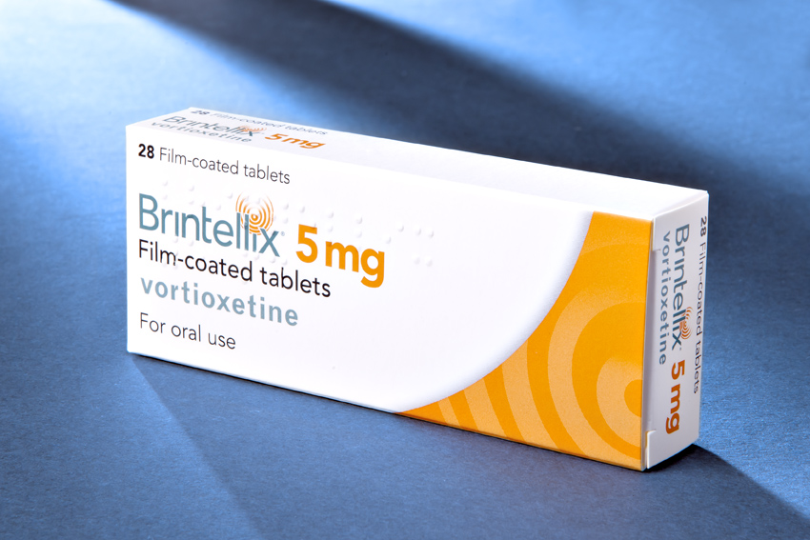
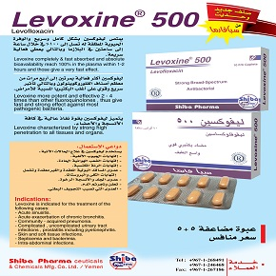

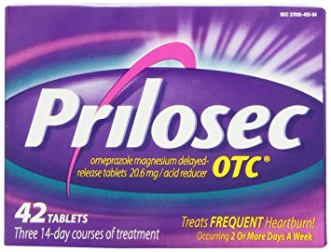
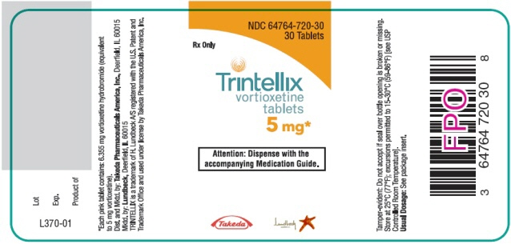
Names changed postmarket approval because of LASA

Slide 27

European Union – EMA
DENOMINACIONES
DISTINTIVAS

Slide 28
European Directive 2001/83/EC (ref2)
European Union
Article 1(20)
The name of the medicinal product:
”…may be either an invented name not liable to confusion with the common name, or common name or scientific name accompanied by a trade mark or the name of the marketing authorization holder.”
Emphasis added.

Slide 29
EMA – Guideline
European Union - EMA
EMA issues 6th update in 2014:
“Guideline on the acceptability of names for human medicinal products processed through the centralized procedure”
“The checking of the (invented) name is part of EMA’s role in evaluating the safety of medicinal products within the authorisation procedure, as the proposed (invented) name(s) could create public health concern or potential safety risk.”

Slide 30
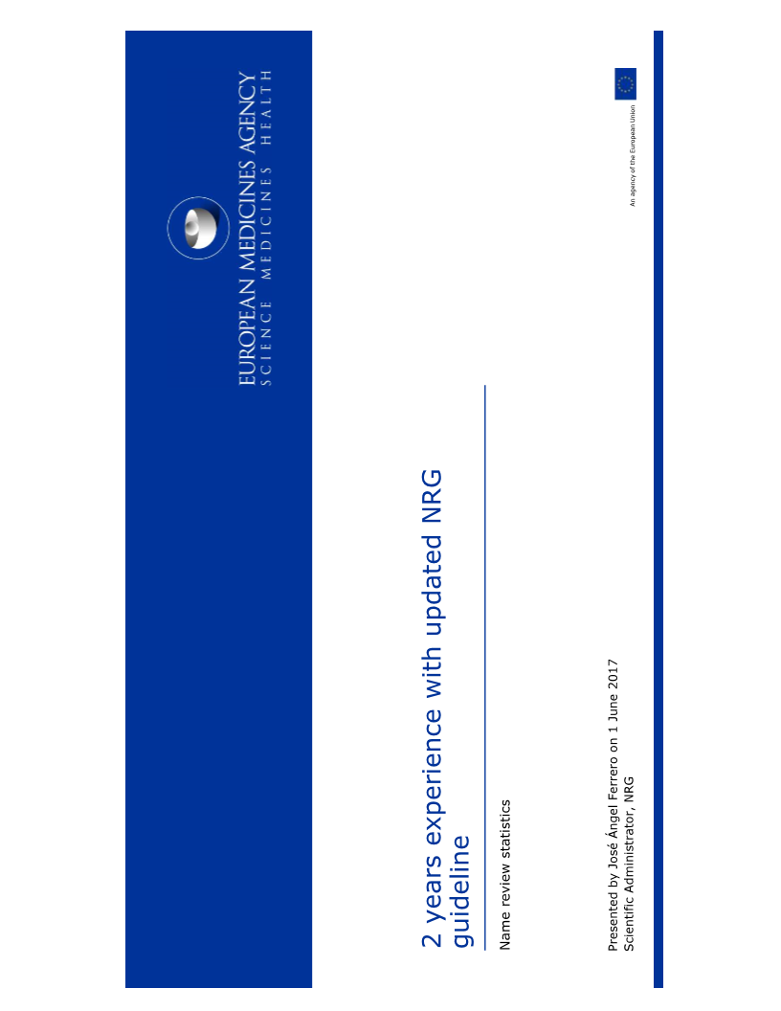
Naming Review Group (NRG) of EMA

Slide 31
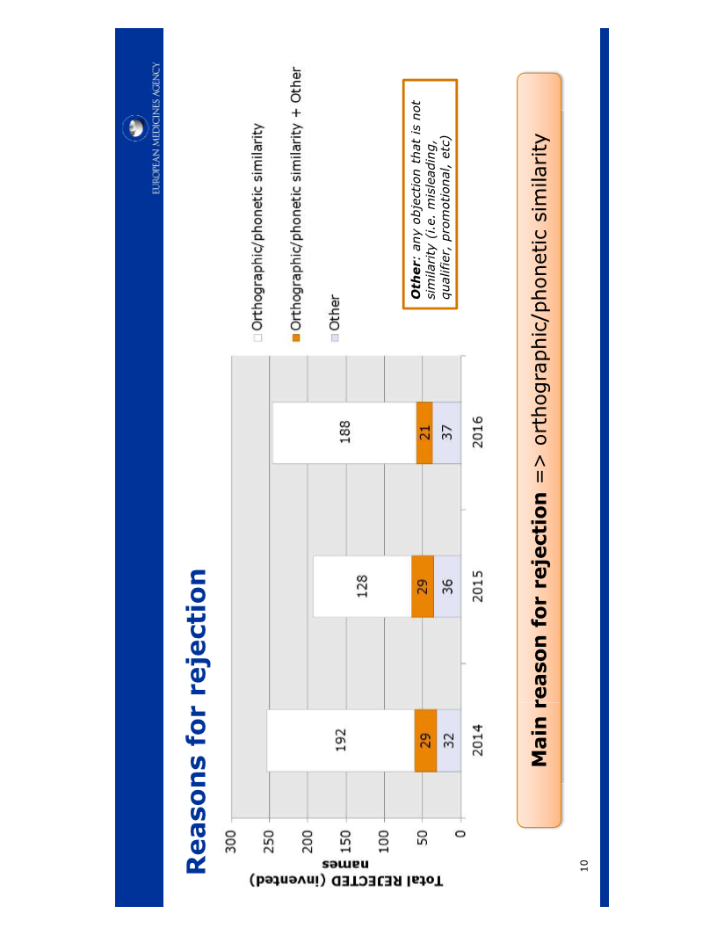
Top Reasons for rejection

Slide 32
Canada – Health Canada (HC)
DENOMINACIONES
DISTINTIVAS

Slide 33
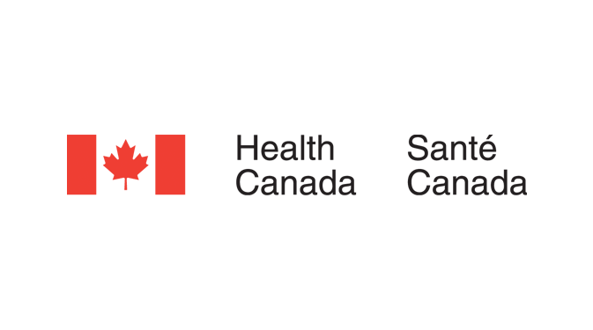
Canadian Food and Drug Regulations as of 2014
Canadian Food and Drug Regulations:
(o) in the case of a drug for human use, an assessment as to whether there is a likelihood that the drug will be mistaken for any of the following products due to a resemblance between the brand name that is proposed to be used in respect of the drug and the brand name, common name or proper name of any of those products:
(i) a drug in respect of which a drug identification number has been assigned…
see C.01.014.1(2)(o) and C.08.002(2)(o)

Slide 34
Canadian Guidance Document
Guidance Document for Industry –
Review of Drug Brand Names
Publication Date: July 2, 2014
Effective Date: June 13, 2015
Policy Objective:
“To provide market authorization holders direction on the process to be followed and information to be submitted to Health Canada regarding the potential for a proposed name to be misleading or confused with another product authorized for use in Canada with the aim of preventing medication errors.”

Slide 35
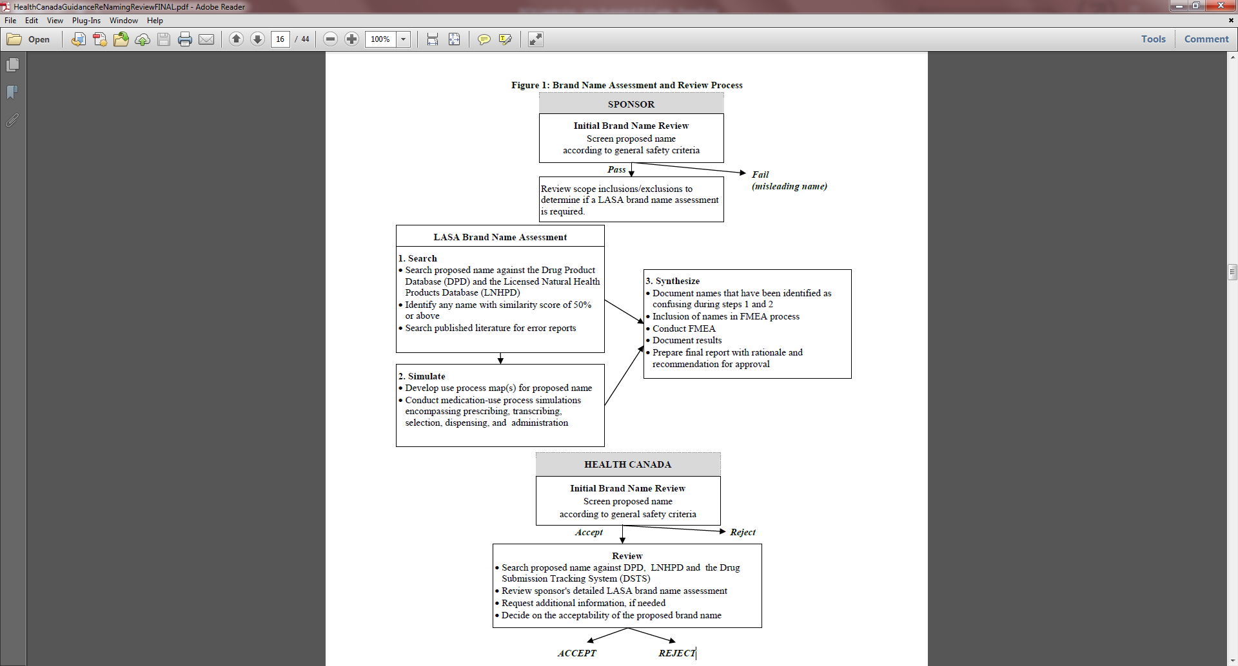
Canadian Guidance – Brand Name Review
LASA Analysis and POCA > 50%

Slide 36
Pharmaceutical Naming - Synthesis
Different Countries – Different Approaches:
Common Themes:
1. Patient safety is paramount;
2. Context is key; and
3. LASA important factor in determination of acceptability

Slide 37
Naming Medicines
There are three types of name for medicines:
Chemical compound name
Scientific approach (impractical and different naming conventions)
Non-proprietary (generic) name
Naming convention of WHO – attempt to be international common name (there are a number of naming conventions, including the WHO: BAN, USAN, AAN)
Trademark (Brand) name
Name owned and developed by the pharmaceutical company selling the medicine

Slide 38
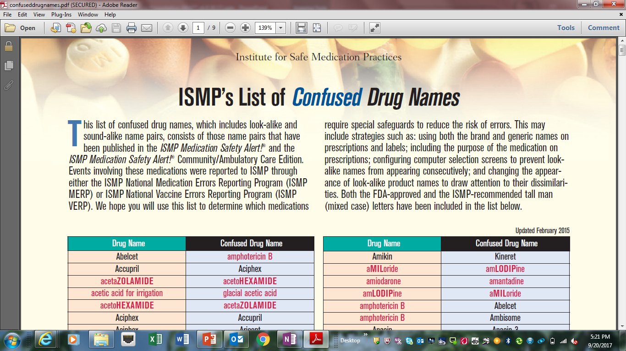
ISMP – Generic AND Brand names – potential medical errors
Notes:
Use of just generic names will not solve the potential; As will be discussed in Monica’s talk, some countries refuse to allow registration without use of the generic names.

Slide 39
Pharmaceutical Generic Naming – Potentially Harmful to Patients
Which names are more confusing:
Generic Names:
sildenafil vs. tadalafil
sildenafil vs. vardenafil
tadalafil vs. vardenafil
OR:
Brand Names:
VIAGRA vs. CIALIS
VIAGRA vs. LEVITRA
CIALIS vs. LEVITRA
POCA
63%
81%
64%
38%
57%
32%
Notes:
INN does its best to distinguish between non-proprietary names, but the naming convention inevitably leads to some level of confusion.

Slide 40
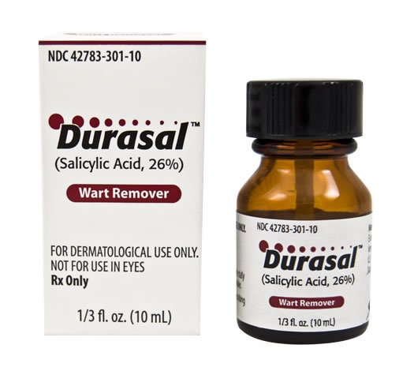
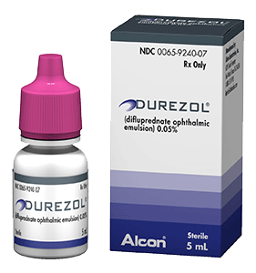
Sound-alike Confusion
The FDA Report was picked up by the media: http://abcnews.go.com/blogs/health/2011/12/29/you-say-durezol-i-say-duresal-fda-warns-of-drug-mix-ups/
https://www.fda.gov/Drugs/DrugSafety/ucm285235.htm - FDA Alerts Pharmacists and Health Care Professionals to Potential for Injury when Dispensing the Similar-Sounding Drugs Durezol and Durasal
Notes:
Through the implementation of POCA and the LASA the likelihood of this type of confusion is reduced. Once an INN is assigned, that is all. There is no feedback opportunity to help with the confusion. With Brands, owners can amend the brand.

Slide 41
The Difference a Letter can make - MEPA
https://www.fda.gov/Drugs/DrugSafety/ucm497942.htm - FDA Drug Safety Communication: FDA approves brand name change for antidepressant drug Brintellix (vortioxetine) to avoid confusion with antiplatelet drug Brilinta (ticagrelor)
Notes:
Through the implementation of POCA and the LASA the likelihood of this type of confusion is reduced. Once an INN is assigned, that is all. There is no feedback opportunity to help with thet confusion. Here in the case of Brintellix the FDA, working with the Brand owner a change was made to Trintellix.

Slide 42
Pharmaceutical Generic Naming – Potentially Harmful to Patients
Generic naming conventions are not universal (BAN, USAN,INN)
Generic names we believe have greater chance of medical errors, and there is no mechanism to remove confusion because of LASA
Likely to constrain product supply and increase costs to countries insisting on generic naming only - packaging change requirements to meet these requirements;
Likely to facilitate entry of counterfeit product to market (Branded labels often harder to replicate); and
Challenges with determining source of product
  Attribution of manufacturing problems
  Patient complaints
  Adverse event reporting

Slide 43
Our Recommendation: Keep Trademarks
AND incorporate POCA
Patient safety is most important consideration
Branding cleared for medication error potential contributes to patient safety
Adopt systematic approach (for example like Brazil and Mexico – BUT without any generic name elements)
Use POCA
  reduces subjectivity
  Increases predictability
  Contributes to safe selection of brand names

Slide 44
Brazil -
Exemplos:
ATORVASTATINA cálcica
Nomes reprovados: POCA
- ATORVAS (3 sílabas/7 letras) 58%
- TORVASTA (3 sílabas/8 letras) 67%
- ciTORVASTAlo (3 sílabas/8 letras) 68%
- ATORciVASTA (4 sílabas/9 letras) 71%
- ATORTINA (4 sílabas/8 letras) 64%
- ATORTYNA (4 sílabas/8 letras) 60%
- ORVASTA (2 sílabas/7 letras) 58%
Ideally – AVOID any link to Non-proprietary names
Nomes aprovados, neste critério: POCA
- VASTA (2 sílabas/5 letras) 42%
- ciVASTA (2 sílabas/5 letras) 48%
- TORVAS (2 sílabas/6 letras) 53%
- TORVASloca (2 sílabas/6 letras) 63%
- TORVA (2 sílabas/ 5 letras) 42%
- TORVAloc (2 sílabas/5 letras) 49%
Notes:
NOTE: the names in Yellow required further trimming to move the POCA scores below 50%, as even the two examples provided gave scores above 50% But, using POCA and creativity it is possible to generate a name with a lower POCA score.
AND recommend following EMA, HC and US – no “generic” name elements – to preserve the non-proprietary naming system. EU Article 1(20) Directive 2001/83/EC (ref2) the name of the medicinal product “..may be either an invented name not liable to confusion with the common name..”

Slide 45


PREGUNTAS???
y
DISCUSIÓN

Slide 46
GRACIAS!
© 2018 Eli Lilly and Company

